Slide 1
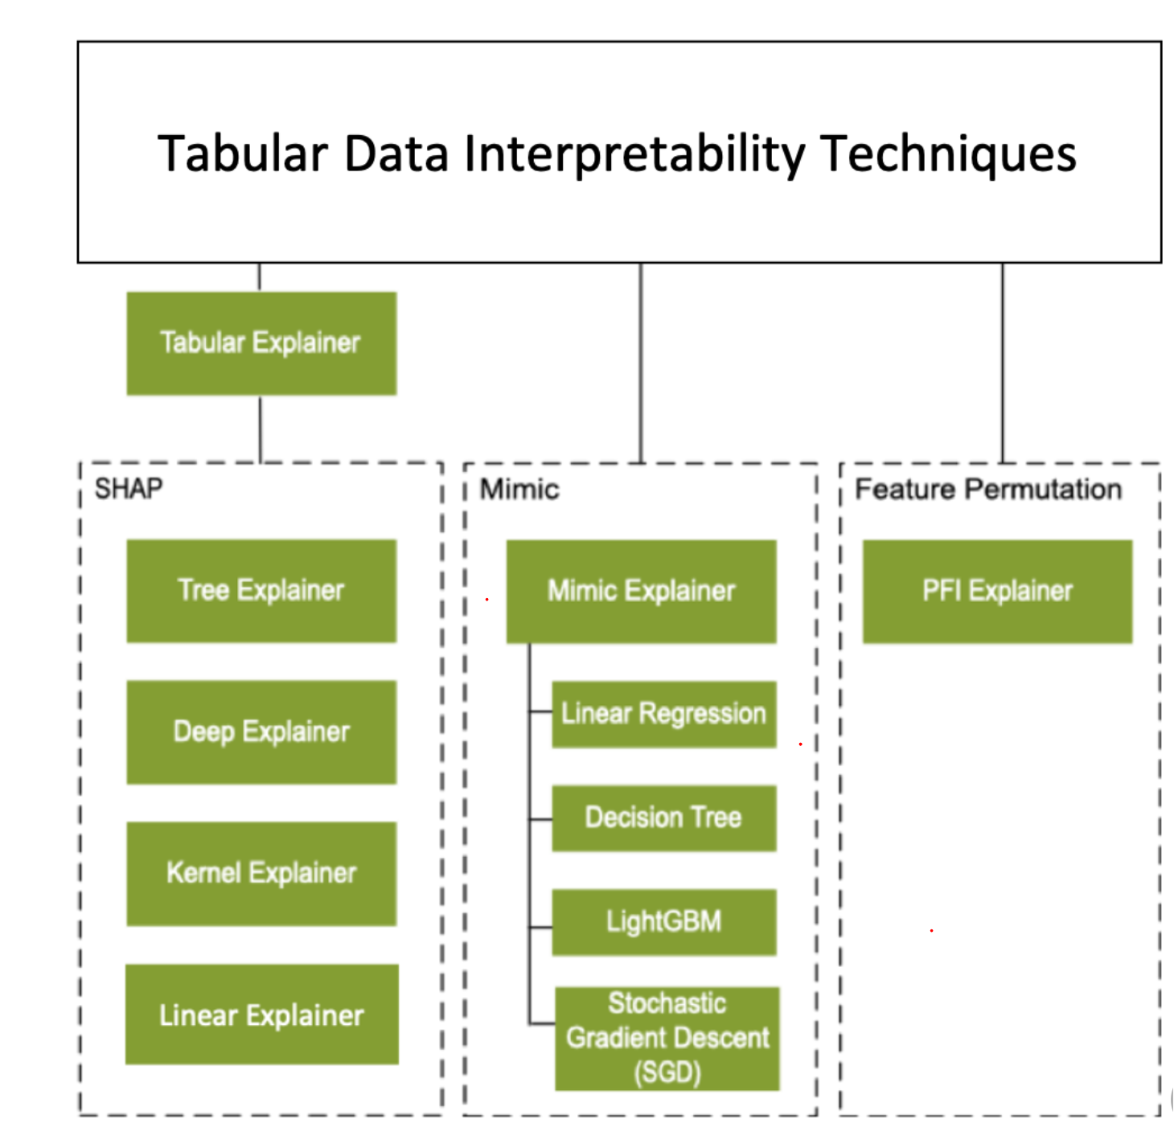
SHAP Interpretability for Black Box Explanations
Notes:
The Shapley value, coined by Shapley (1953)³⁸, is a method for assigning payouts to players depending on their contribution to the total payout. Players cooperate in a coalition and receive a certain profit from this cooperation.

Slide 2

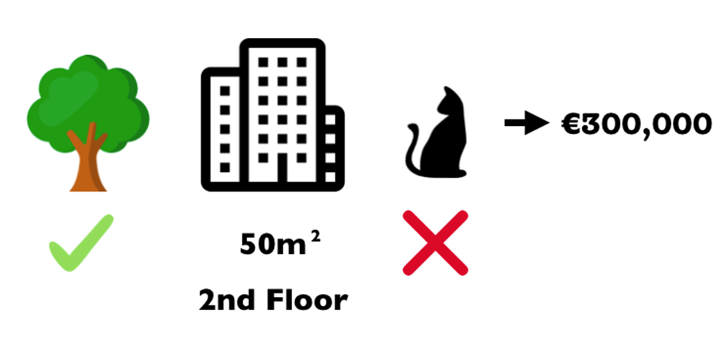






How much has each feature contributed
to the prediction of the price of house
compared to the average prediction
Of $310, 000?
Parks contributed +10k
Cats banned contributed -20k
Wall painting needed contributed -10k
Secure neighborhood contributed +10k
Notes:
SHAP is a very known blackbox explainer which is based on the idea of game theory.
The Shapley value, coined by Shapley (1953)³⁸, is a method for assigning payouts to players depending on their contribution to the total payout. Players cooperate in a coalition and receive a certain profit from this cooperation.
Game Theory Concept
Each feature value: Player
Prediction: Payout

Slide 3
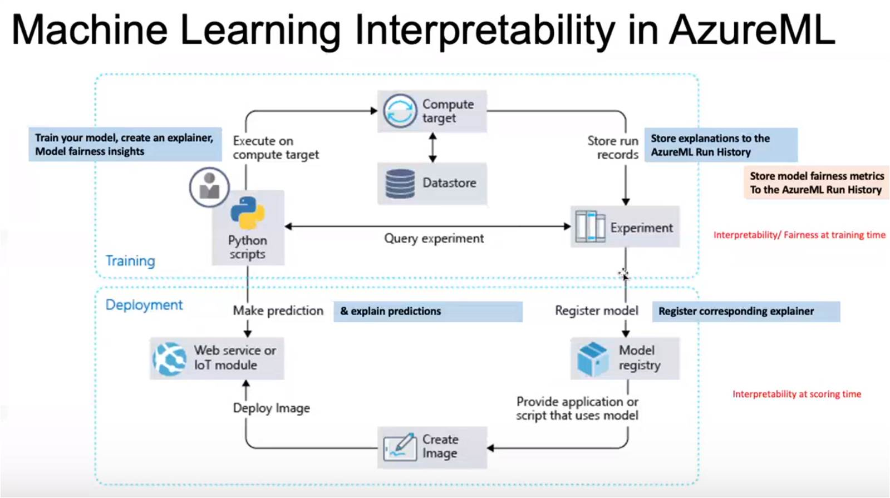

Slide 4
SHAP
Game Theory Concept
Each feature value: Player
Prediction: Payout
Interpretable Machine Learning
Christoph Molnar
Notes:
The Shapley value, coined by Shapley (1953)³⁸, is a method for assigning payouts to players depending on their contribution to the total payout. Players cooperate in a coalition and receive a certain profit from this cooperation.

Slide 5
SHAP
How do we calculate Shapley values?
Take your feature of interest (e.g., cats-banned) and remove it from the feature set
Take the remaining features and generate all possible coalitions
Add and remove your feature of interested to each of the coalitions and calculate the difference it makes
Notes:
Game Theory Concept
Each feature value: Player
Prediction: Payout
depending on their contribution to the total payout. Players cooperate in a coalition and receive a certain profit from this cooperation.

